Slide 1
Module 1.3:
Unsupervised Learning
Clustering; Dimensionality Reduction
ML for Cybersecurity

Slide 2

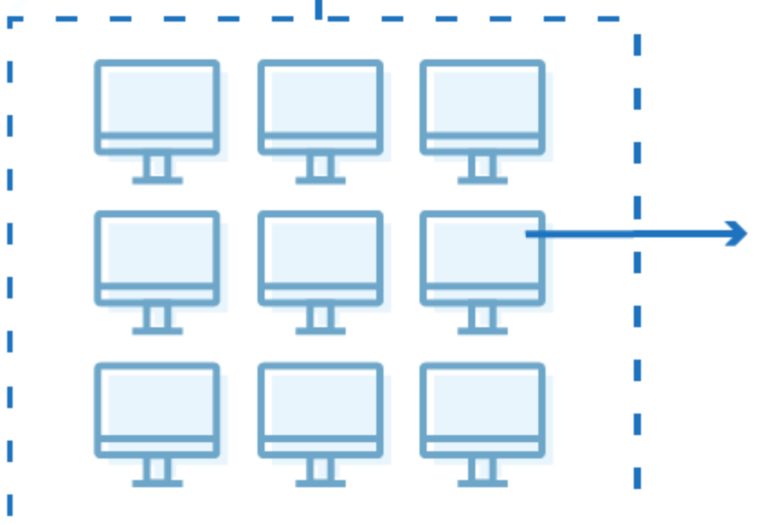


Network Intrusion Detection
Host Intrusion Detection
Anomaly Detection

Slide 3
Unsupervised Learning
Learning without labels
Typically useful for exploratory data analysis (find patterns, visualization)
Most common methods
Clustering (unsupervised classification)
Dimensionality reduction (unsupervised regression)

Slide 4
Clustering

Slide 5
What is Clustering?
Given data points, group into clusters such that
Similar points are in the same cluster
Dissimilar points are in different clusters
Points are typically represented either
in (high-dimensional) Euclidean space
with distances specified by a metric or kernel
Related: Anomaly / outlier detection
Identification of points that “don’t fit well in any of the clusters”

Slide 6
Standard Approaches to Clustering
Hierarchical clustering
Build a tree (bottom-up or top-down), representing distances among data points
Example: single-, average- linkage clustering
Partitional approaches
Define and optimize a notion of “cost” defined over partitions
Example: Spectral clustering, graph-cut based approaches
Model-based approaches
Maintain cluster “models” and infer cluster membership (e.g., assign each point to closest center)
Example: k-means, Gaussian mixture models, …

Slide 7

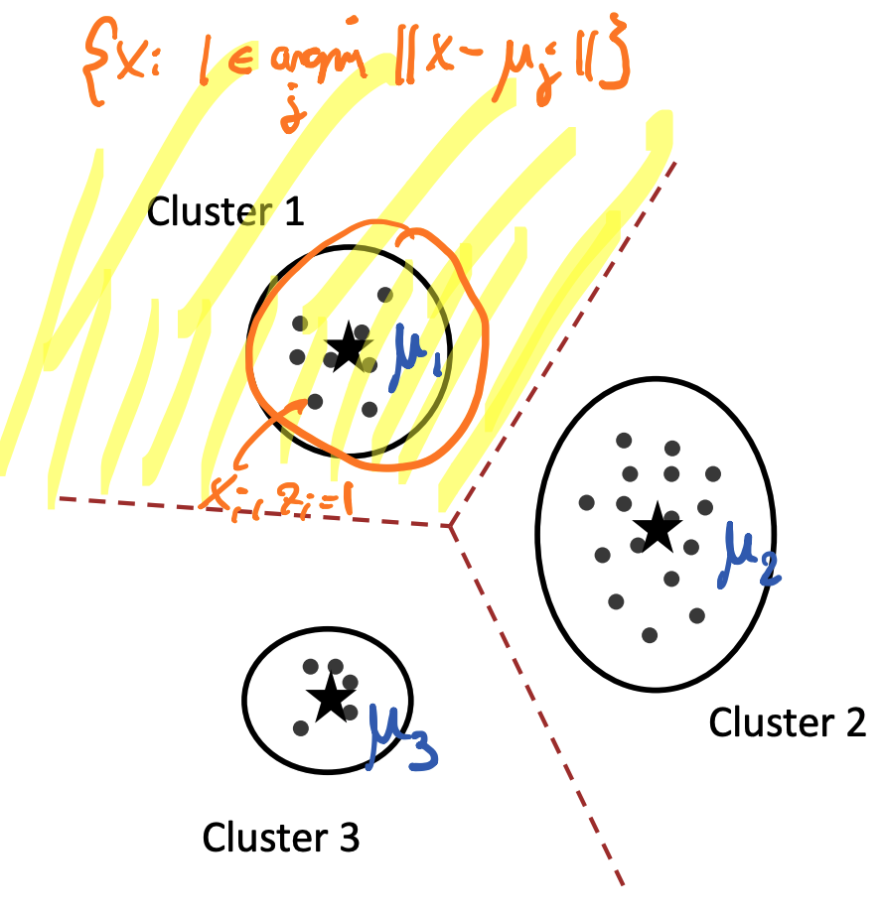
K-means Clustering
Represent each cluster by single point (center)
Assign points to closest center
Induces Voronoi partition
Credit @NOELIAGOROD

Slide 8
K-means Algorithm
Initialize cluster centers
While not converged
Assign each point to closest center
Update center as mean of assigned data points

Slide 9
Properties and Challenges with K-means
Generally only converges to local optimum
Performance strongly dependent on initialization!
Number of iterations required can be exponential
In practice however often converges very quickly
Cannot well model clusters of arbitrary shape
Determining the number of clusters k is difficult

Slide 10
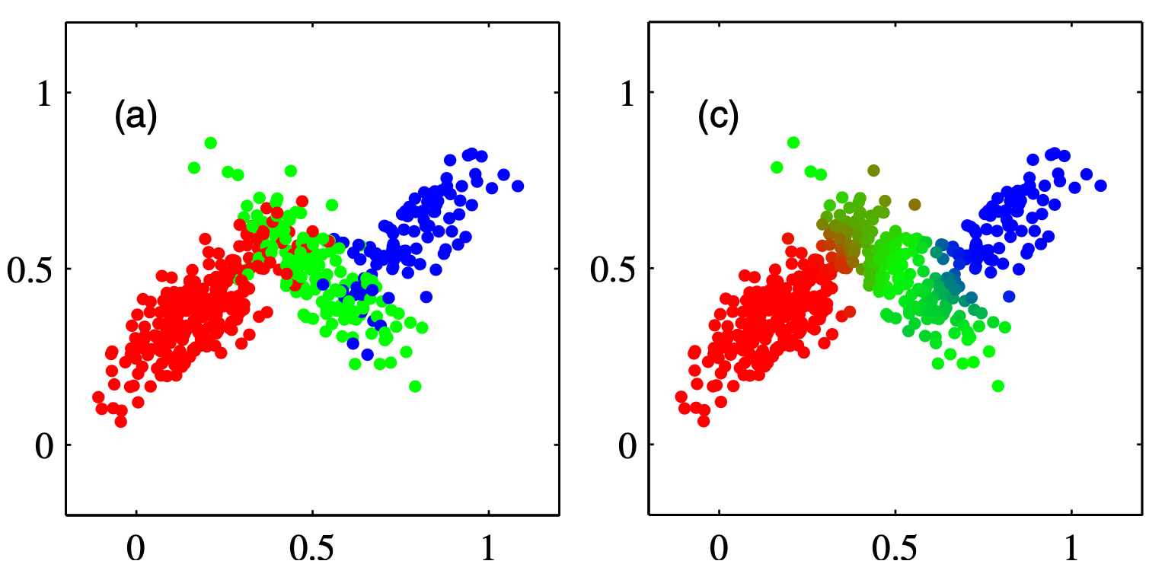
General Case: GMMs and the EM Algorithm
Gaussian Mixture Models (GMMs)
Generative procedure for clustering
Expectation Maximization (EM) for GMMs
First initialize cluster membership weights
While not converged:
Calculate cluster membership weights for each point
Fit clusters to weighted data points

Slide 11
Dimensionality Reduction

Slide 12
Basic Challenge
Given data set
Obtain “embedding” (low-dimensional representation)
Motivation
Visualization (k=1,2,3)
Regularization (model selection)
Unsupervised feature discovery (i.e., determine features from data!)
Anomaly detection

Slide 13
Typical Approaches
Linear dimension reduction
PCA, SVD, LDA
Nonlinear dimension reduction
(parametric or non-parametric)
Credit @NOELIAGOROD

Slide 14
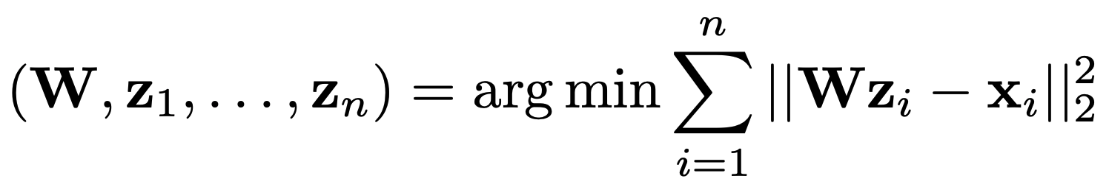

Principal Component Analysis (PCA)
Suppose we wish to project data from d to k dimension:
This is called the Principal Component Analysis problem
Its solution can be obtained in closed form even for k>1

Slide 15
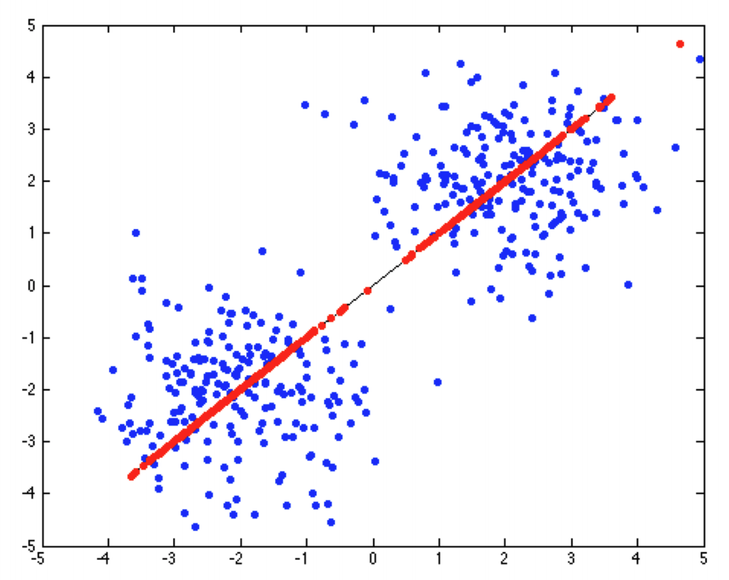
PCA is a Projection
The linear mapping obtained from PCA projects vectors into a k-dimensional subspace
This projection is chosen to minimize the reconstruction error (measured in Euclidean norm)

Slide 16
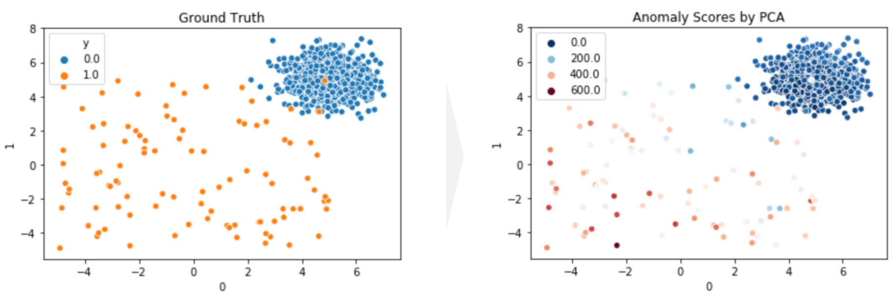
Example: Anomaly Detection with PCA

Slide 17
Concluding Remarks
Unsupervised ML models
Anomaly detection (network/host intrusion detection)
Unsupervised “classification”
Clustering and K-Means algorithm
Unsupervised “regression”
Dimensionality reduction and PCA

